Slide 1
OBJECT RECOGNITION SYSTEM USING IMAGE PROCESSING
Team Members with Roll No:
M. Divya Sree 19911A04E7
G. Praveen 19911A04D6
N. vivek 19911A04F4
M. Shashank Singh 19911A04E6
Guide: Dr. S. Thulasi Prasad

Slide 2
ABSTRACT
An object recognition system using image processing is a computer vision technology that automatically identifies and classifies objects within digital images or video streams. This system involves several stages, including image acquisition, preprocessing, feature extraction, object detection, and classification. In the image acquisition stage, digital images or video frames are captured using a camera or other imaging devices. In the preprocessing stage, the acquired images are enhanced and normalized to ensure optimal quality. In the feature extraction stage, relevant features of the objects are extracted from the preprocessed images. In the object detection stage, the locations of the objects within the images are identified using techniques such as edge detection or template matching. Finally, in the classification stage, the recognized objects are classified into predefined categories based on their features. This system has numerous practical applications, including robotics, surveillance, and autonomous vehicles.
.

Slide 3
Aim
The main objective of an object recognition system is to extract relevant features from an image or video and match them with pre-defined object categories.

Slide 4
Literature review:
We will bootstrap simple images and apply increasingly complex neural networks to them. In the end, the algorithm will be able to detect multiple objects of varying shapes and colors. You should have a basic understanding of neural networks. But the accuracy is low to detect the more multiple objects.

Slide 5
METHDOLOGY
Detecting and recognizing objects in unstructured as well as structured environments is one of the most challenging tasks in computer vision and artificial intelligence research. This paper introduces a new computer vision-based obstacle detection method for mobile technology and its applications. Each individual image pixel is classified as belonging either to an obstacle based on its appearance. The method uses a single lens webcam camera that performs in real-time, and also provides a binary obstacle image at high resolution. In the adaptive mode, the system keeps learning the appearance of the obstacle during operation. The system has been tested successfully in a variety of environments, indoors as well as outdoors, making it suitable for all kinds of hurdles. It also tells us the type of obstacle which has been detected by the system.
Project review -2- ECE Department

Slide 6
TOOLS REQUIRED
HARDWARE REQUIRED
RASPBERRY PI
SD CARD
DRONE
12V BATTERY
MINIMUM 4GB RAM
WINDOWS OS PC 64 BIT
SOFTWARE REQUIRED
PYTHON IDLE
OPENCV
NUMPY
Deep learning using CNN (convolutional neural network) algorithm

Slide 7
HARDWARE BLOCK DIAGRAM
RASPBERRY PI
DEEP LEARNING
SD CARD
DATA SET
WEB CAM
DRONE

Slide 8
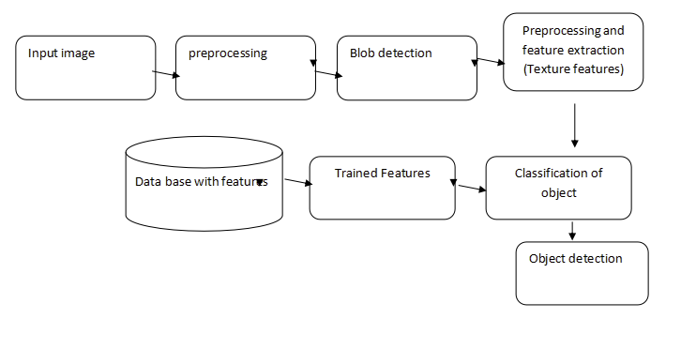
SOFTWARE BLOCK DIAGRAM

Slide 9
FLOWCHART
Camera capture the object
Detection of the object pattern from captured scene
Feature extraction from object
Object detection
Cloud storage database
NO
Matching?
YES
Producing audio output of the recognized text
Project review -2 -ECE Department

Slide 10
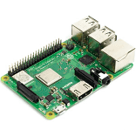
RASPBERRY PI 3B+

Slide 11
RASPBERRY PI specifications
Broadcom BCM2837B0 chipset
1.4GHz Quad-Core ARM Cortex-A53, 4 cores
64 bit CPU
1GB RAM
4 USB 2.0 ports (via LAN7515)
Gigabit Ethernet (via LAN7515, max speed 300Mbps)
PoE (power over Ethernet)
Micro USB power connector
HDMI
CSI camera interface
DSI connector for official screen
3.5mm jack connector supporting stereo audio and composite video
2-pin reset header
Micro SD socket

Slide 12
Algorithm and modules:
Pre-processing:
The aim of pre-processing is an improvement of the image data that suppresses unwilling distortions or enhances some image features important for further processing, although geometric transformations of images (e.g. rotation, scaling, translation)
preprocessing and feature extraction:
Before getting features, various image preprocessing techniques like binarization, thresholding, resizing, normalization etc. are applied on the sampled image. After that, feature extraction techniques are applied to get features that will be useful in classifying and recognition of images

Slide 13
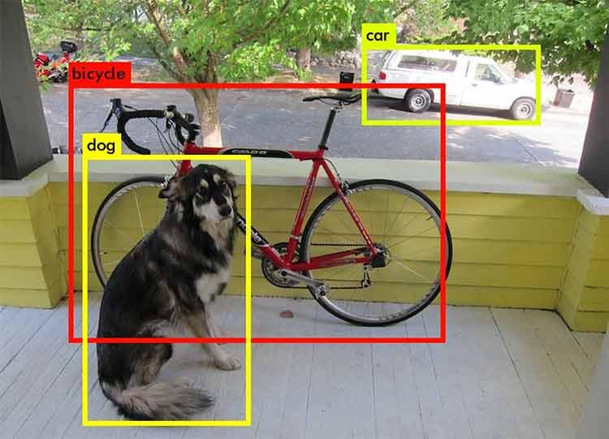
CNN:
A CNN is a kind of network architecture for deep learning algorithms and is specifically used for image recognition and tasks that involve the processing of pixel data
Blob detection:
In computer vision, blob detection methods are aimed at detecting regions in a digital image that differ in properties, such as brightness or color, compared to surrounding regions.

Slide 14
Advantages :
More objects detection
More accuracy
Using yolo object detection is very fast.
Less time taken

Slide 15
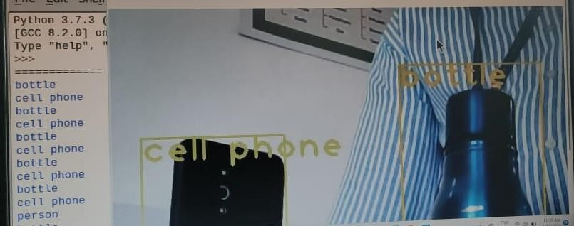
RESULT
Here we are using algorithms like YOLO and RCNN for object detection using raspberry pi. Though the algorithms show accurate results and speed of detection is too fast. Due to the limited computing power of raspberry pi can result in slower inference times and lower accuracy of detection system.

Slide 16
REFERENCE
1. Zhen .Quian and Huang. Debao, (2011), “Moving objects detection based on Space Vector Difference”, IEEE, International conference of Mechatronics and Automation, vol. 1, 646- 651.
2. Cho .Wanhyun, Kim. Sunworl, Ahn .Gukdong and Park .Sangcheol (2011), “Detection and tracking of multiple moving objects in video sequences using entropy mask method and fast level set method”, IEEE.
3. Mandeep. Singh, (2010), “Improved Morphological method in motion detection”, International journal of computer applications, Vol. 5, No. 8.
4. Zhang .Tao, Liu .Zdiwen, Lian .Xiaofeng and Wang .Xiaoyi (2010), “Study on moving objects detection techniques in video surveillance system”, IEEE.
5. Kim .Jiman, Ye .Guensu and Kim .Daijin, (2010), “Moving object detection under free moving camera”, 17th International conference on image processing, IEEE

Slide 17
Any Queries…?

Slide 18


